Slide 1
Capstone
Project
-2-

Slide 2
Data Engineer Bootcamp
Presented by: Amjad, Ghadah, Sadeem, Amal

Slide 3
Objectives
01
Ingest data from AWS RDS and Azure Storage Blob, transforming it using Databricks.
02
Apply Machine Learning to classify post topics and generate top 10 topic reports.
03
Demonstrate Azure's scalable Big Data engineering capabilities.

Slide 4


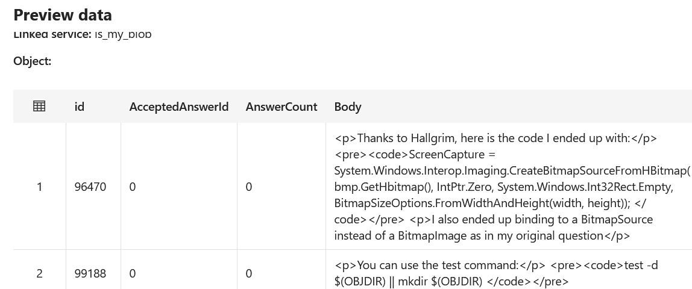
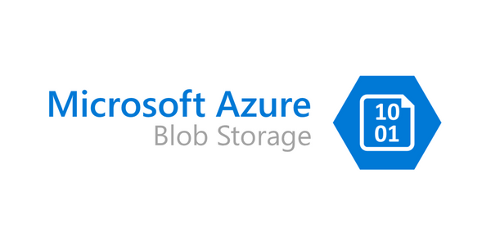
Data Overflow
Stack Overflow
AWS RDS
Users
Data Visualization
Azure Blob Storage
Posts Table

Slide 5
Why big data was used??

Slide 6
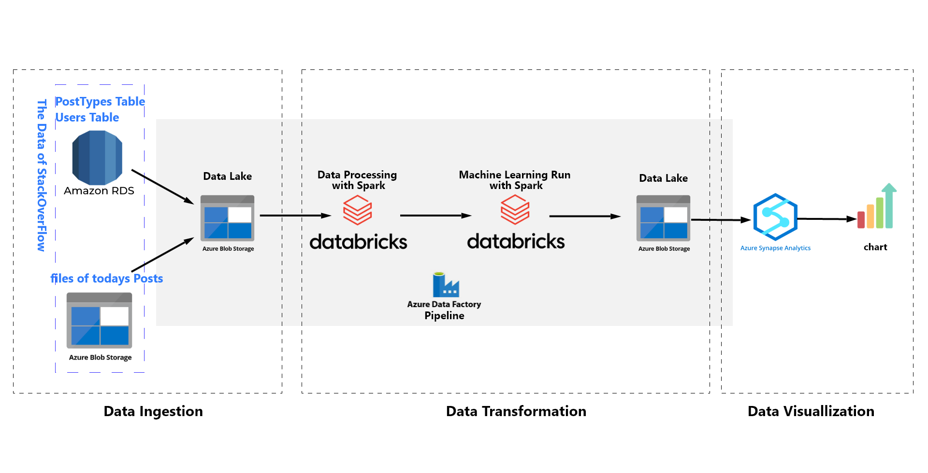
Project Architecture

Slide 7
Azure Demo

Slide 8

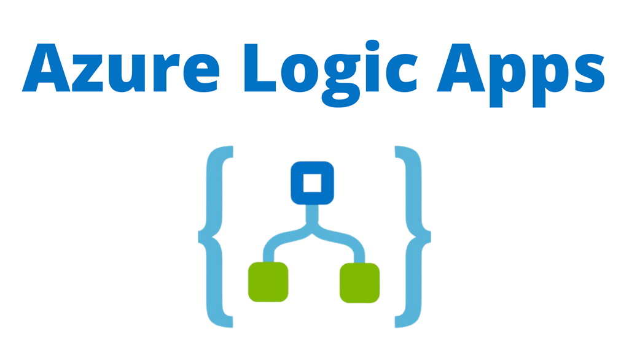

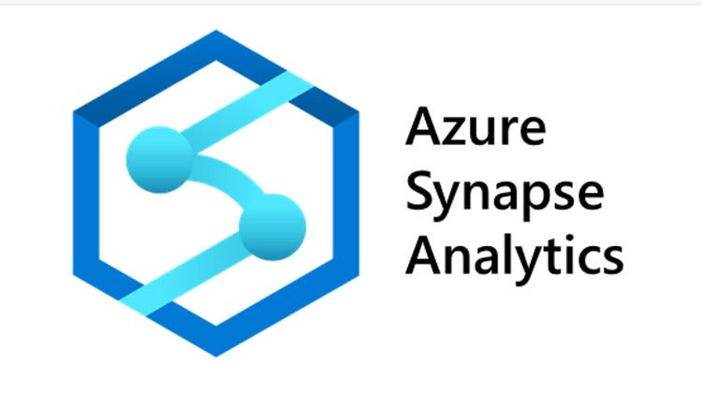


Azure Services
Cybersecurity best practices
Automation
Data Visualization
Devops and CI/CD best Practices
Big Data Handling

Slide 9
How data was processed with Databricks

Slide 10
Databricks Explained
01
Mounted our Storage container to the Azure Databricks directory to access our data.
02
Ran Machine Learning code to train and deploy our model.
03
Conducted data transformation to prepare our data for analysis.

Slide 11
Synapse Explained
01
Visualized the most discussed topics
02
Most & least frequently used tags
03
Tags occurrence break down

Slide 12
FutureFuture
Future
Improvements
Other isualization tools such as Powe Bi and Improving our presentation incase of none technical clients

Slide 13
Thank you!
Amalalsarrar@gmail.com
eng.Sadeemah@gmail.com
ghadaalmutiri2@gmail.com
amjadmalsalem@gmail.com

